Slide 1
Business Essentials
Ebert, Griffin, Starke, Dracopoulos
8th Canadian Edition

Slide 2
CHAPTER 10
Operations Management, Productivity, and Quality

Slide 3
Amazon’s busiest day https://www.youtube.com/watch?v=Z2Bs0nqVyqs
Bracelet exercise
Notes:
These learning objectives are based upon those at the beginning of the chapter. For a review of learning objectives, see the summary at the end of the chapter, as well as the list of key terms.

Slide 4

Learning Objectives
Explain the meaning of the term production (or operations) and describe the four kinds of utility it provides.
Identify the characteristics that distinguish service operations from goods production and explain the main differences in the service focus.
Describe the two types of operations processes.
Describe the factors involved in operations planning and operations control.
Notes:
These learning objectives are based upon those at the beginning of the chapter. For a review of learning objectives, see the summary at the end of the chapter, as well as the list of key terms.

Slide 5
Learning Objectives
Explain the connection between productivity and quality.
Understand the concept of total quality management and describe nine tools that companies can use to achieve it.
Explain how a supply chain strategy differs from traditional strategies for coordinating operations among businesses.
Notes:
These learning objectives are based upon those at the beginning of the chapter. For a review of learning objectives, see the summary at the end of the chapter, as well as the list of key terms.

Slide 6
Creating Value through Production
(LO 10-1)
Operations Management
  a set of methods and technologies used in the production of a good or a service.
Service Operations
  production activities that yield tangible and intangible service products
Goods Production
  production activities that yield tangible products
Notes:
4
4
Learning Objective: 10-1
Page(s): 232

Slide 7
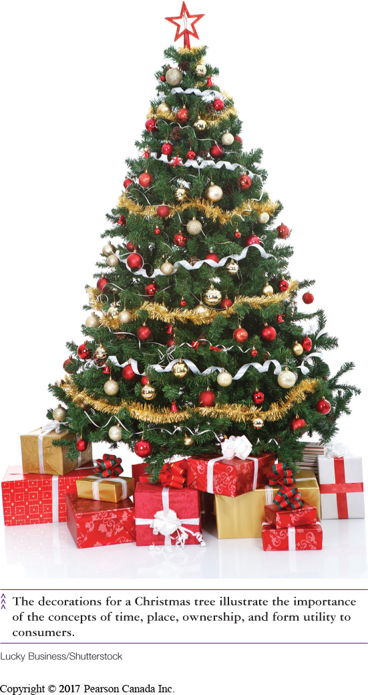
Creating Value through Production
(LO 10-1)
Time Utility
  when the product is available
Place Utility
  where the product is available
Ownership (Possession) Utility
  consumption or use of product
Form Utility
  product’s form (the transformation of raw materials into a finished product)
Notes:
3
3
Learning Objective: 10-1
Page(s): 232

Slide 8
Difference Between Service and
Manufacturing Operations
(LO 10-2)
Interacting with customers
Services can be intangible and unstorable
The customers presence in the operations process
Service quality considerations (intangibles make all the difference)
Notes:
Learning Objective: 10-2
Page(s): 232-233

Slide 9

Operations Processes
(LO 10-3)
Service-Producing Processes
  customers are involved in and can affect the transformation process
  low-contact system
    customers do not need to be physically present
  high-contact system
    customers need to be physically present
Notes:
11
11
Learning Objective: 10-3
Page(s): 236

Slide 10



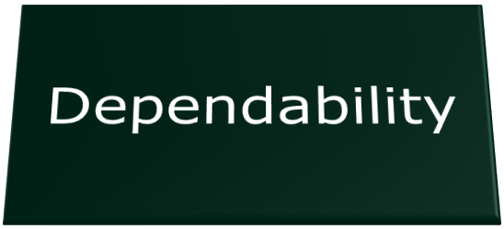
Operations Processes
(LO 10-3)
Business Strategy (Driver of Operations):
Notes:
Learning Objective: 10-3
Page(s): 236
See table 10-2

Slide 11
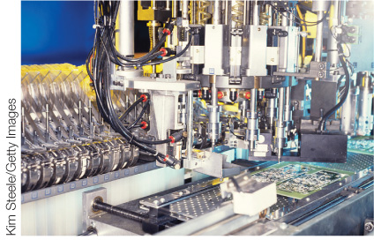
Operations Planning
(LO 10-4)
Successful operations are carefully planned and implemented
  forecasting and planning
capacity
methods planning
quality
location
layout
Notes:
Learning Objective: 10-4
Page(s): 237-240

Slide 12
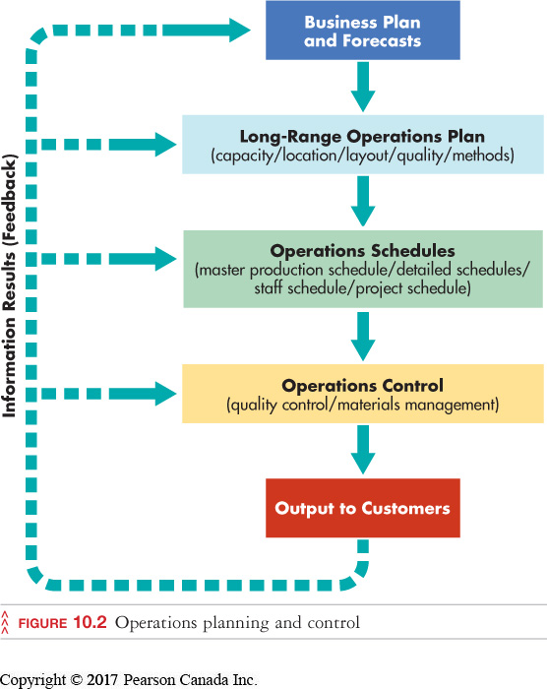
Operations Planning
(LO 10-4)
Operations
Planning
and Control
Notes:
19
19
Learning Objective: 10-4
Page(s): 237
Figure 10.2

Slide 13
Operations Planning
(LO 10-4)
Capacity Planning—Goods and Services
  amount that a firm can produce under normal conditions
Capacity should slightly exceed normal demand
Accommodate seasonal changes and peak times
Address ways to use excess capacity
Notes:
21
21
Learning Objective: 10-4
Page(s): 237

Slide 14
Operations Planning
(LO 10-4)
Layout Planning
Process Layout
  Equipment and people are grouped by function
Cellular Layout
  Used when families of products can follow similar flow paths
Product Layout
  Organizing equipment and people to produce one type of product
      assembly lines, industrial robotics, lean manufacturing
Notes:
Learning Objective: 11-4
Page(s): 237-238
See Figure 10.3

Slide 15
Operations Scheduling
(LO 10-4)
Scheduling Goods Operations
Master Production Schedule (top level)
  which products, when, what resources, what time period
Scheduling Service Operations
  low-contact services:
    based on desired completion dates and/or arrival
  high-contact services:
    customer is directly involved (impacts scheduling)
Notes:
Learning Objective: 10-4
Page(s): 241

Slide 16
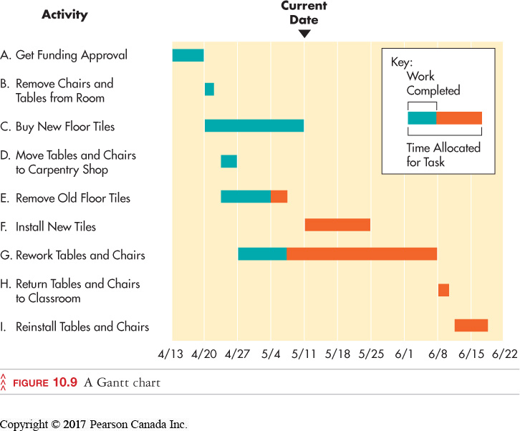
Operations Scheduling
(LO 10-4)
Gantt Charts
  diagram of steps in the project and time required for each
  can be used to check progress
Notes:
Learning Objective: 10-4
Page(s): 242

Slide 17
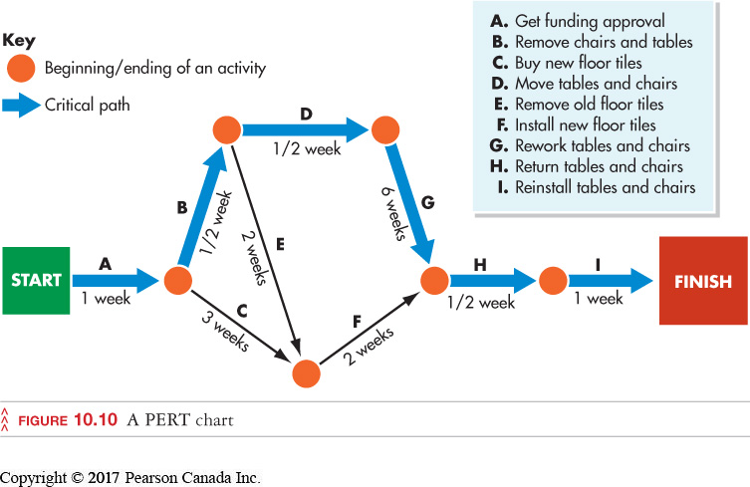
Operations Scheduling
(LO 10-4)
PERT Charts
  specifies the sequence and critical path of steps in a project
  can identify activities that will cause delay
Notes:
Learning Objective: 10-4
Page(s): 242

Slide 18
Operations Control
(LO 10-4)
Operations Control
  monitoring performance by comparing results to original plans and schedules
follow-up-checking to ensure that production decisions are being implemented
materials management
production-process control
Notes:
Learning Objective: 10-4
Page(s): 242

Slide 19
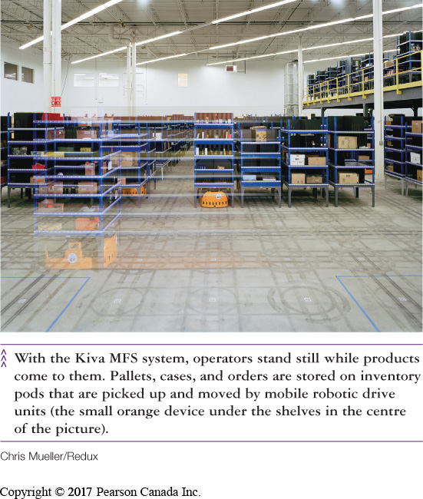
Operations Control
(LO 10-4)
Materials Management
  planning, organizing, and controlling the flow of materials from purchase to distribution of finished goods
transportation
purchasing
warehousing
inventory control
supplier selection
Notes:
37
37
Learning Objective: 10-4
Page(s): 243

Slide 20
Operations Control
(LO 10-5)
Worker training
Just-in-time production systems
Tools for Process Control
Material requirements training
Quality control
Notes:
30
30
Learning Objective: 10-5
Page(s): 243

Slide 21
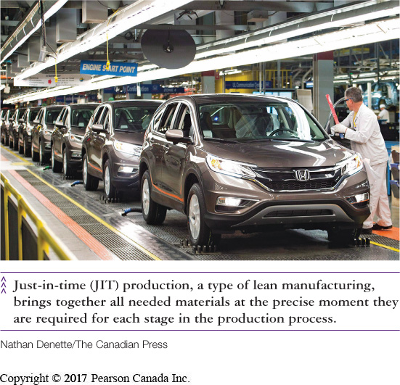
Operations Control
(LO 10-5)
Just-in-Time Production Systems (JIT)
  parts are delivered when they are needed
    resources continually flow from raw materials to the finished product
    saves on warehouse costs
    smooth movement of product components
Notes:
45
45
Learning Objective: 10-5
Page(s): 243

Slide 22
Total Quality Management (TQM)
(LO 10-6)
Includes all activities and parts of the business (customers, suppliers, employees)
Leadership and customer focus are key
Requires highest level of commitment (no defects are tolerable)
Highlights continuous improvement
All employees are responsible for maintaining quality standards
Notes:
14
14
Learning Objective: 10-6
Page(s): 245

Slide 23
Tools For Quality Assurance
(LO 10-6)
Goal is to improve work methods and products
May involve brainstorming, discussion, and the use of quality/cost study
Groups of employees from various areas meet to define, analyze, and solve quality problems
Quality-Improvement Teams
Notes:
26
26
Learning Objective: 10-6
Page(s): 248
Notes
Quality improvement teams (circles) greatly improve employee attitudes, imparting self-worth and a sense of ownership of quality.

Slide 24
Tools For Quality Assurance
(LO 10-6)
Benchmarking
  compares the quality of a firm’s output with the quality of the output of the industry’s leaders
internal
  compare to past performance
external
  compare to competitors’ best practices
Notes:
27
27
Learning Objective: 10-6
Page(s): 248

Slide 25
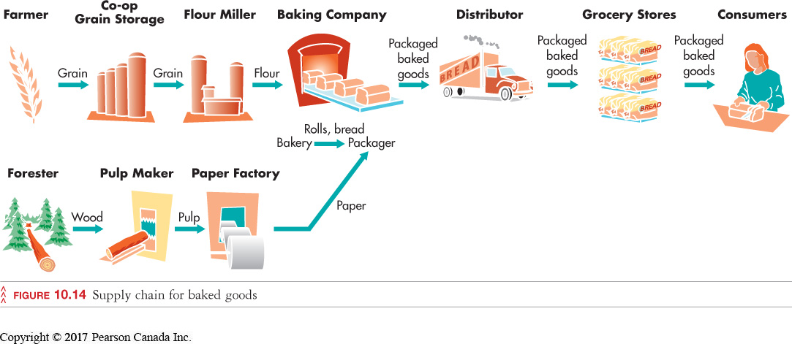
Tools For Quality Assurance
(LO 10-7)
Adding Value Through Supply Chains
Supply Chain (Value Chain)
  a group of companies and stream of activities involved in getting the product from raw materials to the end consumer
Notes:
Learning Objective: 10-7
Page(s): 249

Slide 26
QUICK-CHECK QUESTIONS
1) Many of us will pay an extra service fee to get cash from private ATM machines because of the ________ utility it provides.
A) place
B) marketing
C) form
D) ownership
Answer:
A) place

Slide 27
QUICK-CHECK QUESTIONS
3) _______ charts break down large projects into steps and specify the time required to perform each one. They not only show the necessary sequence of activities but identify the critical path for meeting project goals.
    A) GANTT
    B) PERT
    C) JIT
    D) MRP
Answer:
B) PERT

